Slide 1
ORec : An Opinion-Based Point-of-Interest Recommendation Framework
Speaker: Jim-An Tsai
Advisor: Professor Jia-ling Koh
Author: Jia-Dong Zhang, Chi-Yin Chow, Yu Zheng
Date:2017/1/3
Source: CIKM ’15

Slide 2
Outline
Introduction
Method
Experiment
Conclusion

Slide 3
Introduction
Notes:
https://www.yelp.com/biz/%E6%B0%B8%E5%92%8C%E8%B1%86%E6%BC%BF%E5%A4%A7%E7%8E%8B-%E5%8F%B0%E5%8C%97%E5%B8%82%E5%A4%A7%E5%AE%89%E5%8D%80-2?osq=Restaurants
https://foursquare.com/explore?mode=url&near=Taipei%2C%20Taiwan&nearGeoId=72057594039596277&q=Food

Slide 4
Motivation

Slide 5
Purpose

Slide 6
Framework

Slide 7
Outline
Introduction
Method
Experiment
Conclusion

Slide 8
Polarity Detection
Phase 1: Opinion Phrase Extraction
Step 1: Tip preprocessing.
Step 2: Opinion phrase extraction.
Phase 2: Aspect Clustering
Step 1: Aspect distance calculation.
Step 2: Grouping aspects into clusters.
Step 3: Opinion aggregation.
Phase 3: Supervised Polarity Detection
Step 1: Predicting of naive Bayesian classifier
Step 2: Training of naive Bayesian classi

Slide 9
Phase 1: Opinion Phrase Extraction
Step1: Tip preprocessing
Use the Stanford natural language parsers
1. part of speech. ex: good: adj, price: noun
2. lemmatized to a base. ex: loves, loving => love
3. grammatical dependencies.
ex: input: “the taste is not bad.”
>>nsubj(bad, taste), neg(bad, not)
Notes:
https://www.zhihu.com/question/27215318

Slide 10
Phase 1: Opinion Phrase Extraction
Step2: Opinion phrase extraction
Use SentiWordNet’s opinion words
These opinion words can be used as the indicators of opinion phrases, then grammatical dependency with an opinion word can regard as an opinion phrase. ex: nsubj(bad, taste) has opinion word “bad”, then nsubj(bad, taste)>>opinion phrase <taste, bad>
If the negation dependency “neg(o, not)” exists in the same sentence, the opinion phrase ⟨a;o⟩ will be reversed into opinion phrase ⟨a; not o⟩.

Slide 11
Phase 2: Aspect Clustering
Step 1: Aspect distance calculation
Based on WordNet
Define the aspect dissimilarity or distance based on the semantic relationships of words.
Using these features to calculate words distances.
Notes:
https://en.wikipedia.org/wiki/Hyponymy_and_hypernymy

Slide 12
Phase 2: Aspect Clustering
Step 2: Grouping aspects into clusters
Apply farthest-point clustering algorithm
Input: A = {ai}, distance matrix between aspects, maximum distance threshold dmax
1. choose arbitrary aspect in A as the first cluster center
2.
3. Aspect ai ∈ A is assigned to its nearest cluster ck ∈ C.

Slide 13
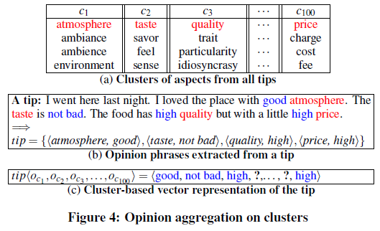
Phase 2: Aspect Clustering
Step 3: Opinion aggregation

Slide 14
Phase 3: Supervised Polarity Detection
Step 1: Predicting of naive Bayesian classifier
Notes:
https://read01.com/RMjz5.html

Slide 15
Phase 3: Supervised Polarity Detection
Step 2: Training of naive Bayesian classifier

Slide 16
Opinion-based Recommendation
1. Fusion with Social Link
2. Fusion with Geographical Information
3. Combining Social-Geographical Influences

Slide 17
Fusion with Social Link

Slide 18
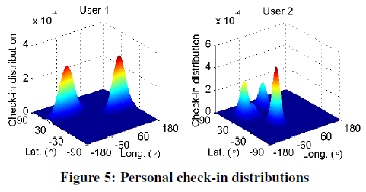
Fusion with Geographical Information

Slide 19
Combining Social-Geographical Influences

Slide 20
Review of Framework

Slide 21
Outline
Introduction
Method
Experiment
Conclusion

Slide 22
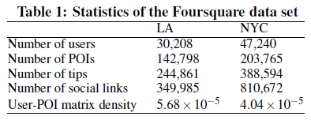
Data Sets
1. Yelp Challenge data set [24] for polarity detection. This data set has 113,993 tips labeled by ratings for 15,585 POIs from various categories including Food, Nightlife, etc.
2. Foursquare data set

Slide 23
Performance Matrix
For polarity detection:
For POI recommendations

Slide 24
Polarity Detection Accuracy

Slide 25
POI Recommendation Accuracy

Slide 26
Outline
Introduction
Method
Experiment
Conclusion

Slide 27
Conclusion
This paper proposes an opinion-based POI recommendation framework ORec to overcome the two challenges:
1. Detecting the polarities of tips
2. Integrating them with social links and geo-
graphical information.

